Slide 1
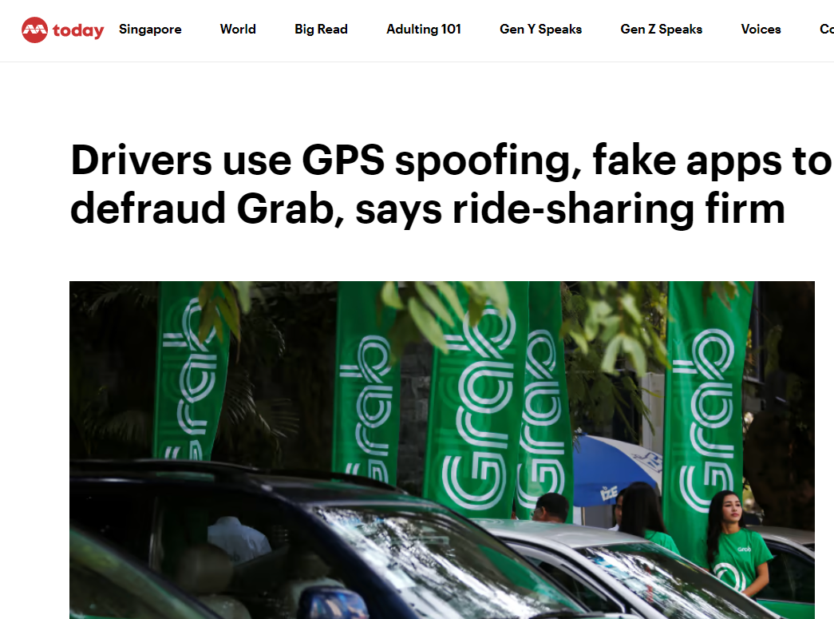
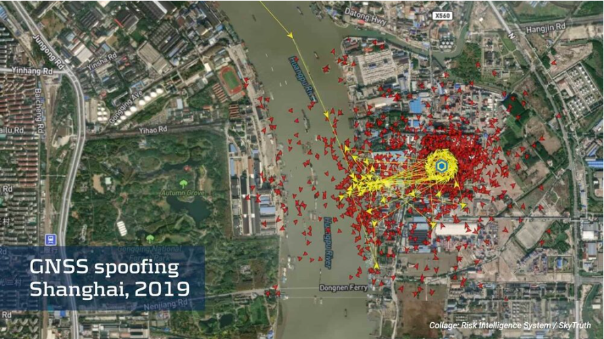
https://maritime-executive.com/editorials/gps-jamming-and-spoofing-at-port-of-shanghai
https://www.todayonline.com/singapore/grab-outlines-ways-its-drivers-try-defraud-ride-sharing-firm
Notes:
Good afternoon prof and fellow students,
Today I would like to bring your attention to the important cases that has happened related to my project.
--Case 1
In May 17 2019,
a GRAB drivers was found using spoof GPS tools to fake their location and pretend they are in a particular location when they are not
so they can secure a ride ahead of drivers who are actually at the location causing Majority of GRAB drivers cannot secure any ride.
--Case 2
In December 2019, several ships in the Port of Shanghai reported experiencing GPS disruptions that affected their ability to navigate and led to the ships being guided off course. The disruptions occurred over a period of several days and affected a wide range of vessels, including cargo ships, tankers, and passenger vessels.
After investigating the incident, experts concluded that the GPS disruptions were likely caused by a GNSS spoofing attack. Spoofing involves broadcasting false GNSS signals that are designed to mimic the signals that would normally be received from GNSS satellites. These false signals can then be used to deceive GPS receivers and cause them to calculate incorrect location and timing information.
The Port of Shanghai incident is notable for its scope and duration, as well as its potential impact on the safety and efficiency of maritime operations. In addition to disrupting the navigation of the affected vessels, the incident also raised concerns about the potential for malicious actors to use GNSS spoofing to interfere with critical infrastructure and operations.
delayed shipments increased storage costs or penalties for missed delivery deadlines.
Damage to reputation:
All these incidents have resulted in loss in Financial and Damage in reputation.
References:
-Case 1: https://www.todayonline.com/singapore/grab-outlines-ways-its-drivers-try-defraud-ride-sharing-firm
-Case 2: https://maritime-executive.com/editorials/gps-jamming-and-spoofing-at-port-of-shanghai

Slide 2
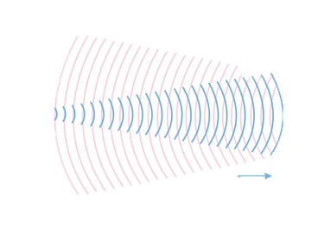

Secure Authentication Scheme for GNSS System
Developing
Notes:
Which Bring us to how

Slide 3
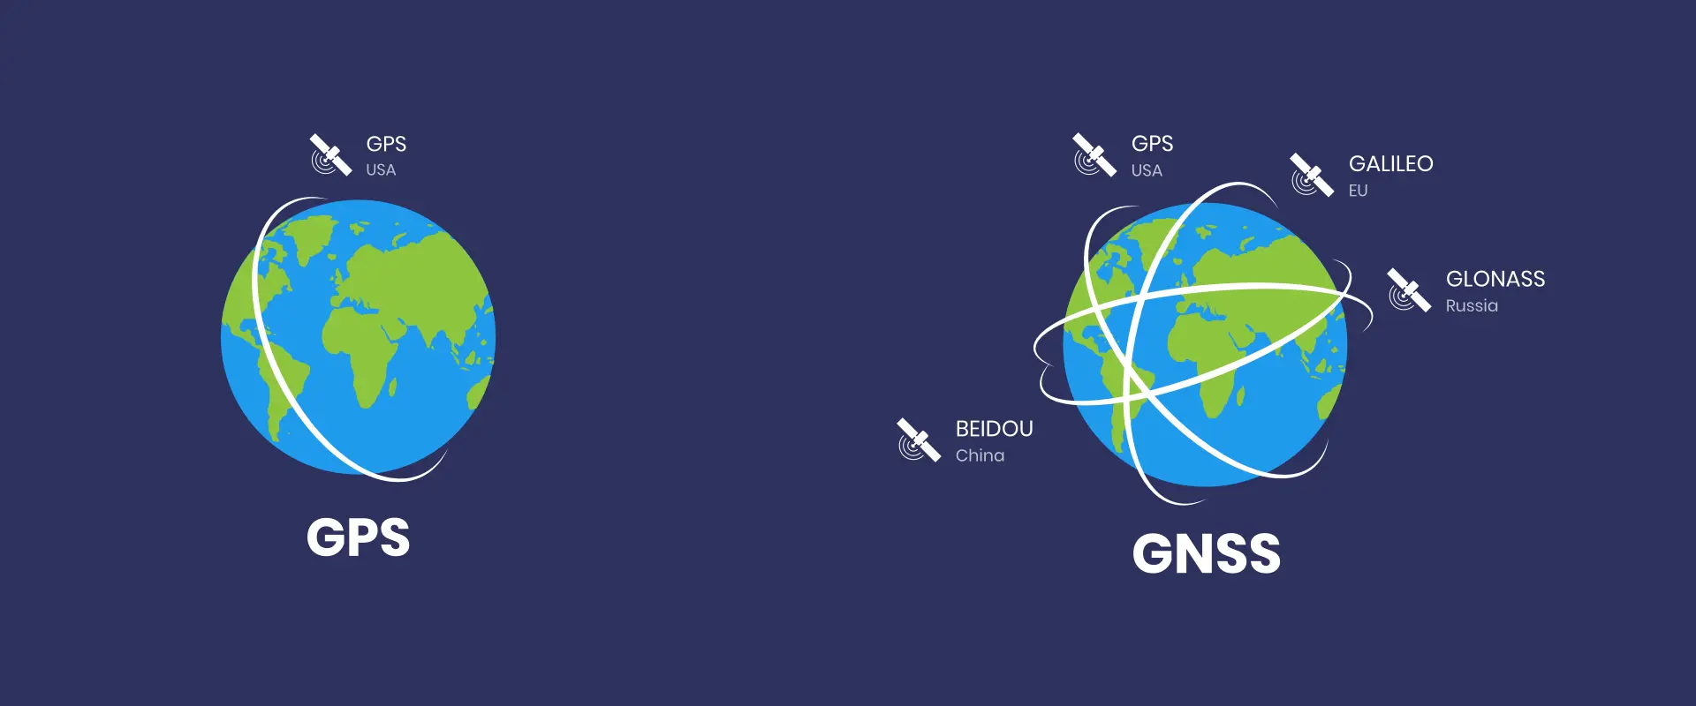

Background
Navigation and location-based services
Emergency services
Transportation
Economic impact
Notes:
Navigation and location-based services: Many applications and services that you use on a daily basis rely on GNSS technology for accurate navigation and location information. For example, GPS navigation systems in cars and mobile phones use GNSS to provide directions and help you navigate to your destination.
Emergency services: GNSS technology is critical for emergency services such as police, fire, and ambulance services. Accurate location information provided by GNSS can help emergency responders quickly and efficiently locate and reach the scene of an incident, potentially saving lives.
Economic impact: GNSS technology has become an important driver of economic growth and innovation, with many businesses and industries relying on it for their operations. Any disruption or compromise to GNSS signals can potentially have an economic impact.
Transportation: GNSS technology is used extensively in transportation systems, including aviation, maritime, and land-based transportation. In aviation, pilots rely on GNSS for accurate navigation and landing, while air traffic control uses GNSS to monitor and manage aircraft movements. In maritime transportation, GNSS is used for ship navigation and safety, while in land-based transportation, GNSS is used for vehicle navigation, tracking, and fleet management.

Slide 4
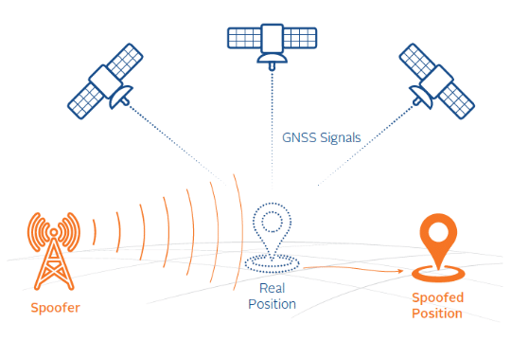
GNSS Signal Vulnabilities
Notes:
Reference:
https://www.everythingrf.com/community/what-is-gps-spoofing
GNSS spoofing is a technique used to manipulate or deceive GNSS receivers by broadcasting false GNSS signals that mimic the legitimate signals transmitted by the GNSS satellites. GNSS spoofing attacks can be carried out using a range of techniques, including direct, relay, and replay attacks.
In a direct spoofing attack, the attacker generates a fake GNSS signal using a signal generator or software-defined radio (SDR) and broadcasts it in the vicinity of the target GNSS receiver. The fake signal is designed to mimic the legitimate GNSS signals transmitted by the satellites, but with slightly different timing or power levels. The target GNSS receiver may then receive the fake signal and use it to calculate its position, resulting in incorrect location information.
In a relay spoofing attack, the attacker intercepts the legitimate GNSS signal using a receiver, and then re-transmits the signal to the target receiver with a slight delay. This causes the target receiver to receive the same signal twice, with the second signal appearing to come from a different direction than the first signal. The target receiver may then use the false signal to calculate its position, resulting in incorrect location information.
In a replay spoofing attack, the attacker records a legitimate GNSS signal and then replays it to the target GNSS receiver with a slight delay. This causes the target receiver to receive the same signal twice, with the second signal appearing to come from a different location than the first signal. The target receiver may then use the false signal to calculate its position, resulting in incorrect location information.
GNSS spoofing attacks can have a range of consequences, depending on the device or system being targeted. For example, a spoofed GNSS signal could cause a drone to crash or a ship to steer off course, leading to safety risks or financial losses. As a result, it is important to implement appropriate security measures to protect against GNSS spoofing attacks, such as using authentication and encryption to verify the integrity of the GNSS signals.

Slide 5
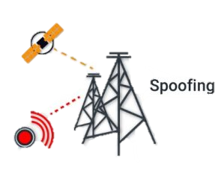




Past Research
Objective
Direct Spoofing
Replay Spoofing
Get Data
Sending Data
Spoofing
Authenticate
Relay Spoofing
Time-stamp
HMAC
HMAC
Notes:
Direct, relay, and replay spoofing are different types of attacks that can be used by attackers to manipulate or disrupt GNSS (Global Navigation Satellite System) signals. The main differences between these types of attacks are as follows:
Direct Spoofing: In direct spoofing, an attacker broadcasts a false GNSS signal with a higher signal strength than the legitimate signal. This causes the receiver to accept the false signal and use it for navigation or other applications. Direct spoofing can be used to deceive the receiver into providing incorrect location information, causing it to navigate to the wrong location or perform other unintended actions.
Relay Spoofing: In relay spoofing, an attacker intercepts the legitimate GNSS signal and rebroadcasts it to the receiver. However, the attacker introduces a delay or manipulates the signal in some other way before rebroadcasting it. This causes the receiver to accept the false signal and use it for navigation or other applications. Relay spoofing can be used to deceive the receiver into believing it is at a different location than it actually is, which can be used for various malicious purposes.
Replay Spoofing: In replay spoofing, an attacker records a legitimate GNSS signal and then broadcasts it later to the receiver. The attacker may modify the recorded signal to introduce a delay or manipulate the signal in some other way. This causes the receiver to accept the false signal and use it for navigation or other applications. Replay spoofing can be used to deceive the receiver into believing it is at a different location than it actually is, which can be used for various malicious purposes.
Direct Spoofing: In 2013, researchers at the University of Texas at Austin used a small, low-cost device to broadcast a false GNSS signal and successfully deceive a drone into changing its course. This demonstrated the potential for direct spoofing attacks to be used against unmanned aerial vehicles (UAVs) and other GNSS-enabled devices.
Relay Spoofing: In 2016, researchers at the University of Texas at Austin used a relay attack to manipulate the position of a yacht during a simulated race. The researchers used a small boat equipped with a GNSS receiver and a transmitter to intercept and rebroadcast the legitimate GNSS signal with a slight delay. This caused the yacht's onboard GNSS receiver to accept the false signal and steer the yacht off course.
Replay Spoofing: In 2018, researchers at the University of Texas at Austin used a replay attack to manipulate the position of a Tesla Model S car. The researchers recorded a legitimate GNSS signal from the car's onboard receiver and then replayed the signal with a slight delay. This caused the car's onboard GNSS receiver to accept the false signal and change its navigation route.
While there have been several real-life incidents of direct GNSS spoofing attacks, there have been fewer reported incidents of relay and replay attacks. However, here are a few examples of real-life incidents where these types of attacks may have been used:
Ship Collision in the Black Sea: In June 2017, a cargo ship collided with another vessel in the Black Sea, resulting in the deaths of several crew members. Some reports suggest that the incident may have been caused by a GPS spoofing attack, where the attackers used a relay or replay attack to deceive the ship's onboard GNSS receiver.
GPS Disruption in Israel: In 2019, Israel's Civil Aviation Authority reported that several commercial aircraft had experienced GPS disruptions while flying over the country. The disruptions were believed to be caused by a GPS spoofing attack, although it is unclear whether relay or replay attacks were used.
GPS Disruption in Russia: In 2016, several Russian airports reported GPS disruptions that affected the accuracy of landing systems. The Russian government initially denied any involvement, but later acknowledged that the disruptions may have been caused by GPS spoofing attacks using relay or replay techniques.
It is important to note that in many cases, the exact methods used in a GNSS spoofing attack may not be known or disclosed, and it can be difficult to definitively attribute an incident to a particular type of attack. However, these incidents highlight the potential risks and consequences of GNSS spoofing attacks, including those that use relay or replay techniques.

Slide 6

Conclusion
Direct Spoofing
Falsifying the source address of a message to make it appear to come from a legitimate sender.
Relay Spoofing
Intercepting and altering a message before relaying it to the intended recipient.
Replay Spoofing
Replaying a recorded message to make it appear as a fresh message.
Notes:
My project aims to develop Authentication scheme system that can handle all type of potential GNSS spoofing and measure the effective of using time stamp HMAC as Hash function for the authentication.
This project will protect

Slide 7


